Slide 1
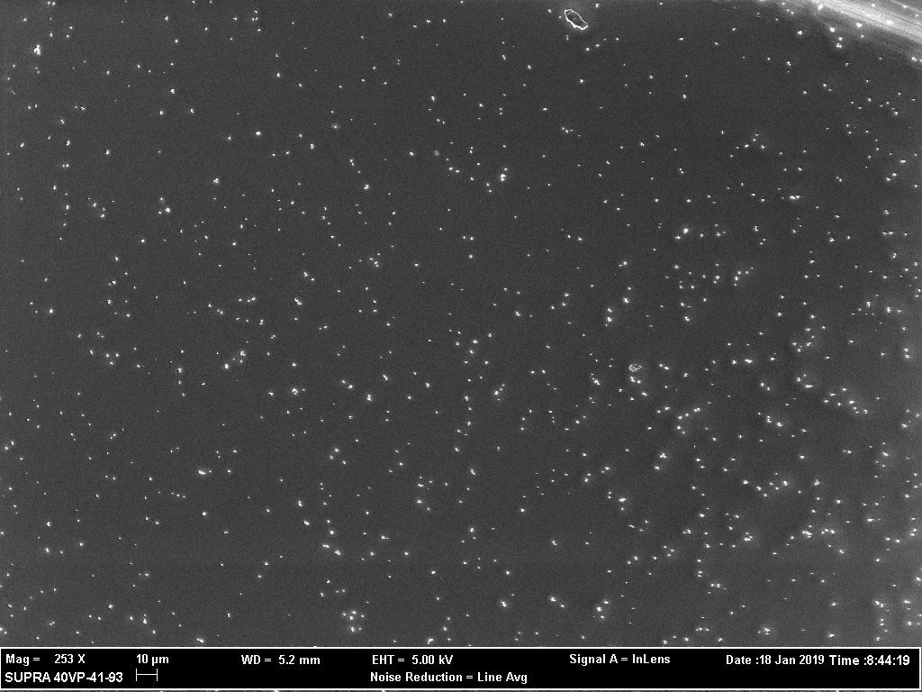



Copper Nanoparticles
By Alyssa Smith
Mentors: Clifford Coss, Edgar Civitello, and John Gibbs

Slide 2
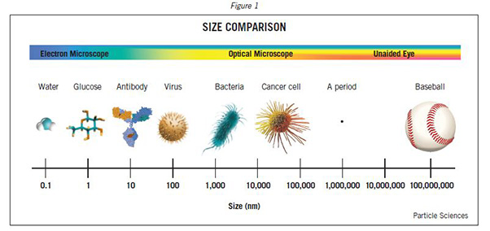
Introduction
The goal is to achieve a nanoparticle that has a smooth, spherical shape and that is roughly 300 nm in diameter. They also needed to be as uniform as possible and well dispersed.
In order to see these nanoparticles we had to use a Scanning Electron Microscope (SEM).

Slide 3
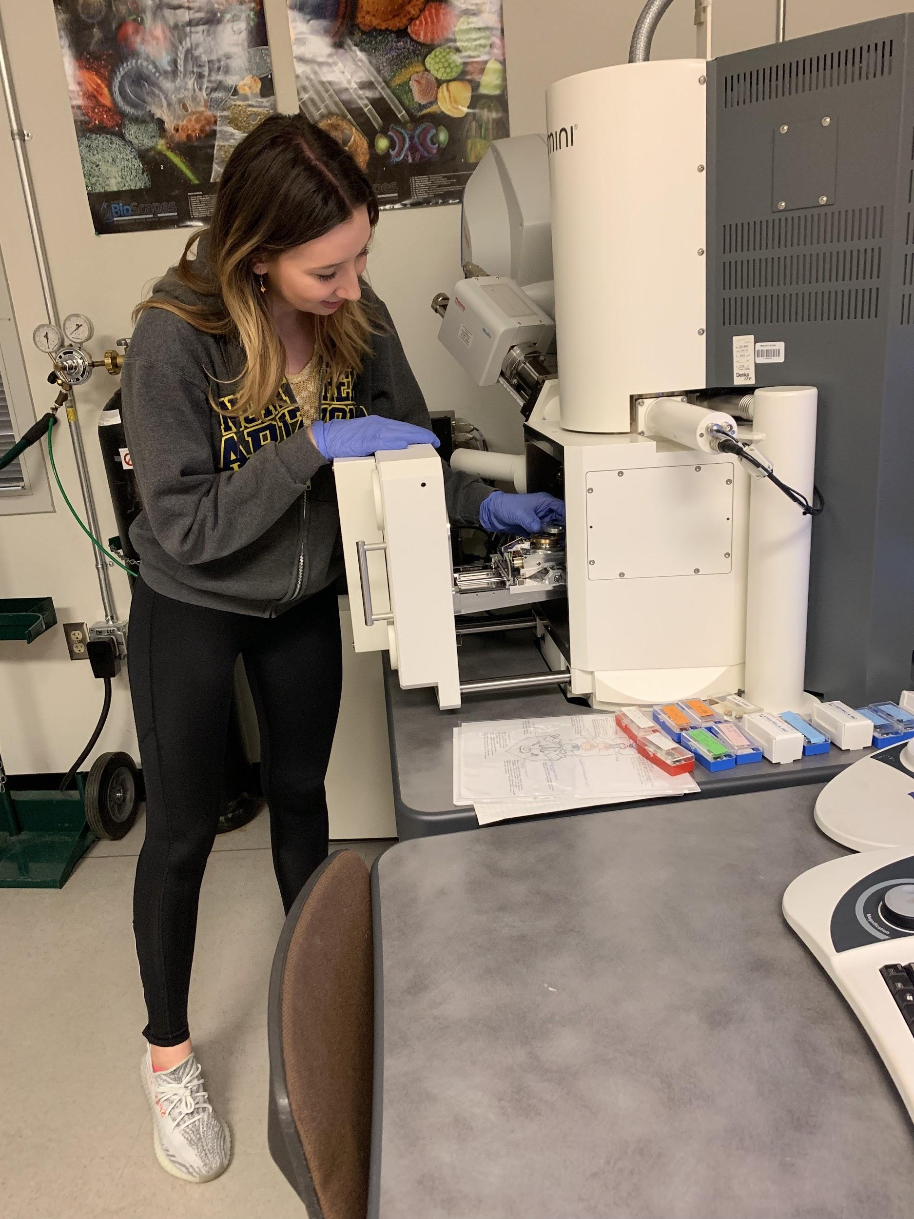
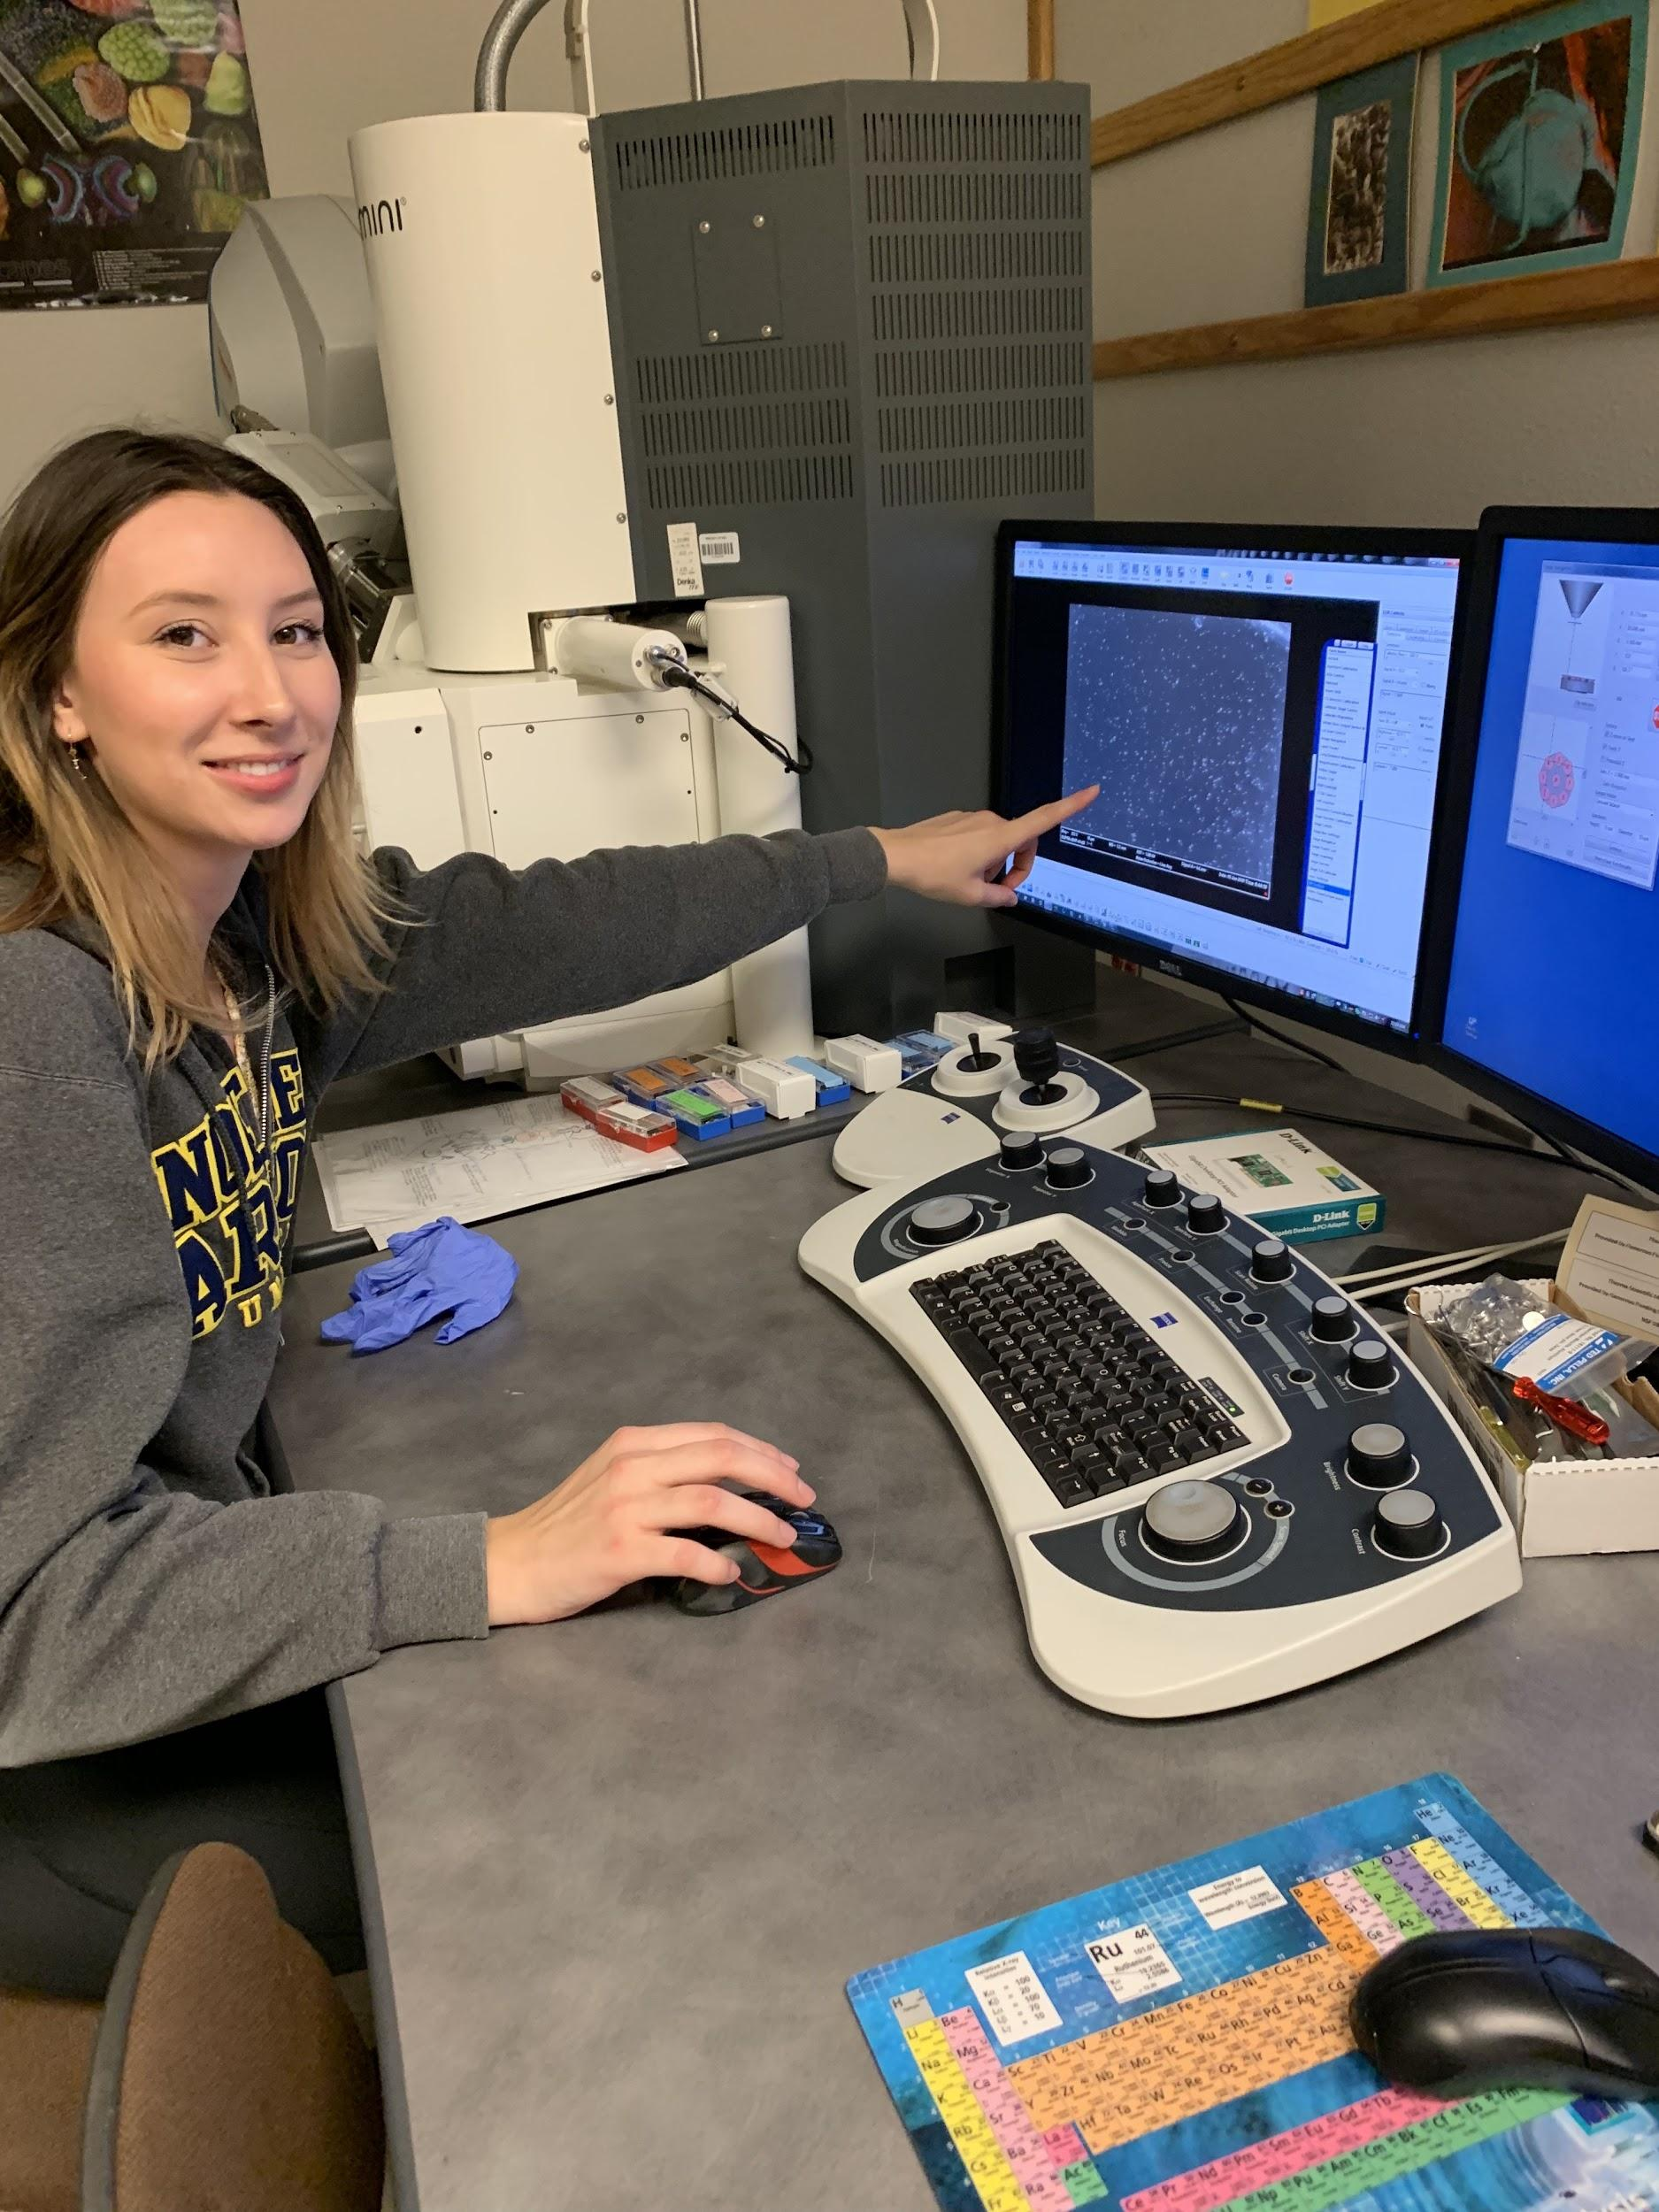
SEM Scanning Electron Microscope
A scanning electron microscope scans the surface of a sample with a beam of electrons that are reflected to form an image.

Slide 4
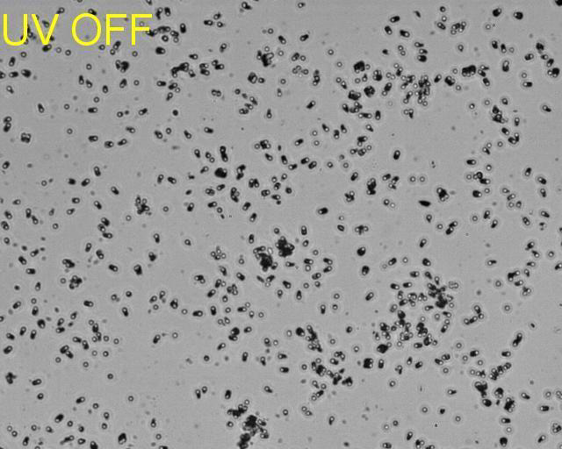
Purpose
Uniformity allows for use as a new type of catalytic nanomotor with unique and useful properties.
The movement of these copper(I) oxide particles can be initiated and sustained using an external light source.

Slide 5
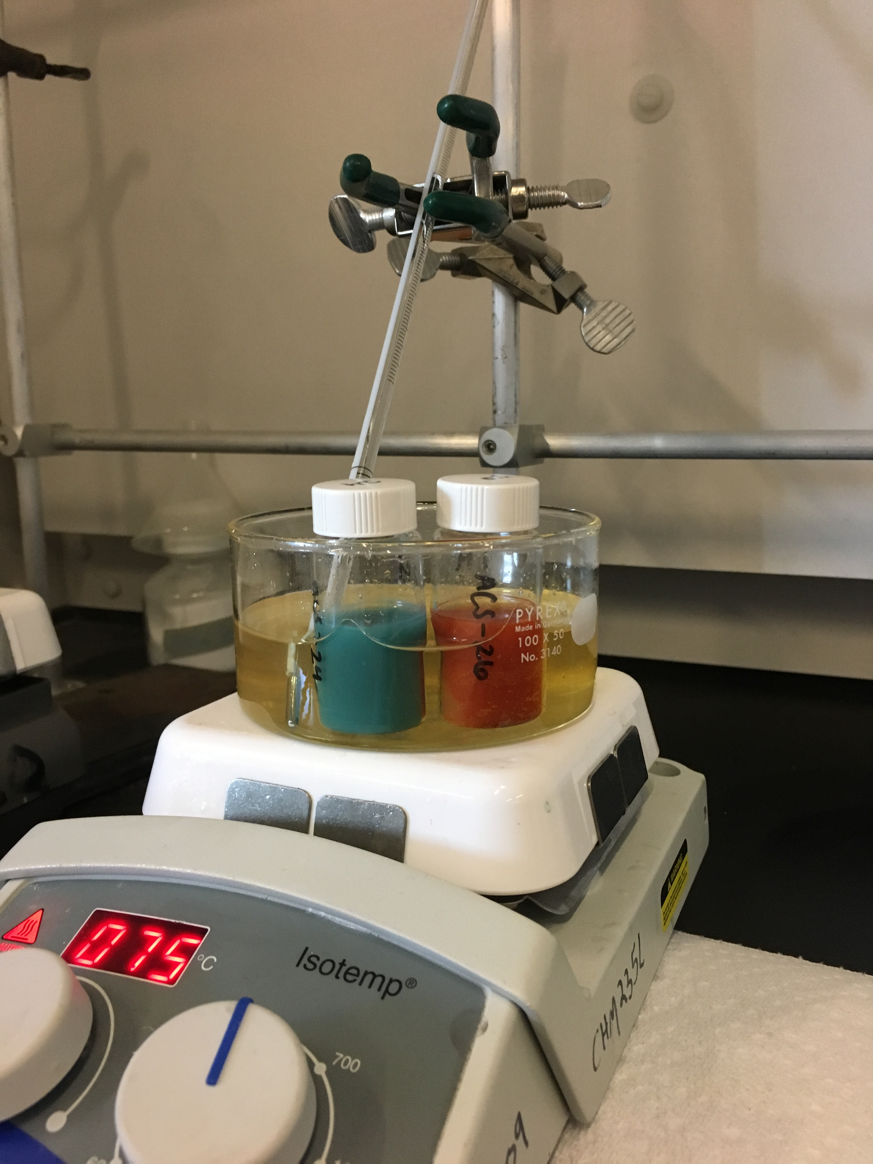
How Did I Make the Nanoparticles?
Using a form of benedict's test I reduced copper(II) ions to copper(I) ions
Heating of glucose causes the transfer of electrons to the aldehyde causing the glucose to oxidize and the copper to reduce.
Through this reaction the copper(I) oxide nanoparticles precipitate out of solution.
Cu(I) is insoluble so it doesn’t dissolve into solution

Slide 6
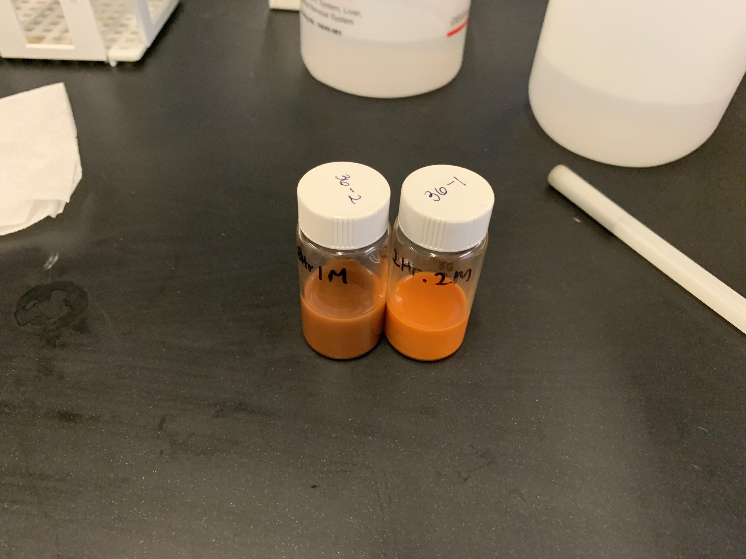
Basic Procedure
Mix copper(II) acetate, glucose, and 4 mL of EtOH at the desired temperature while stirring for 5 minutes.
Add the 8 mL of NaOH dropwise over 3 minutes.
Allow the reaction to run.

Slide 7
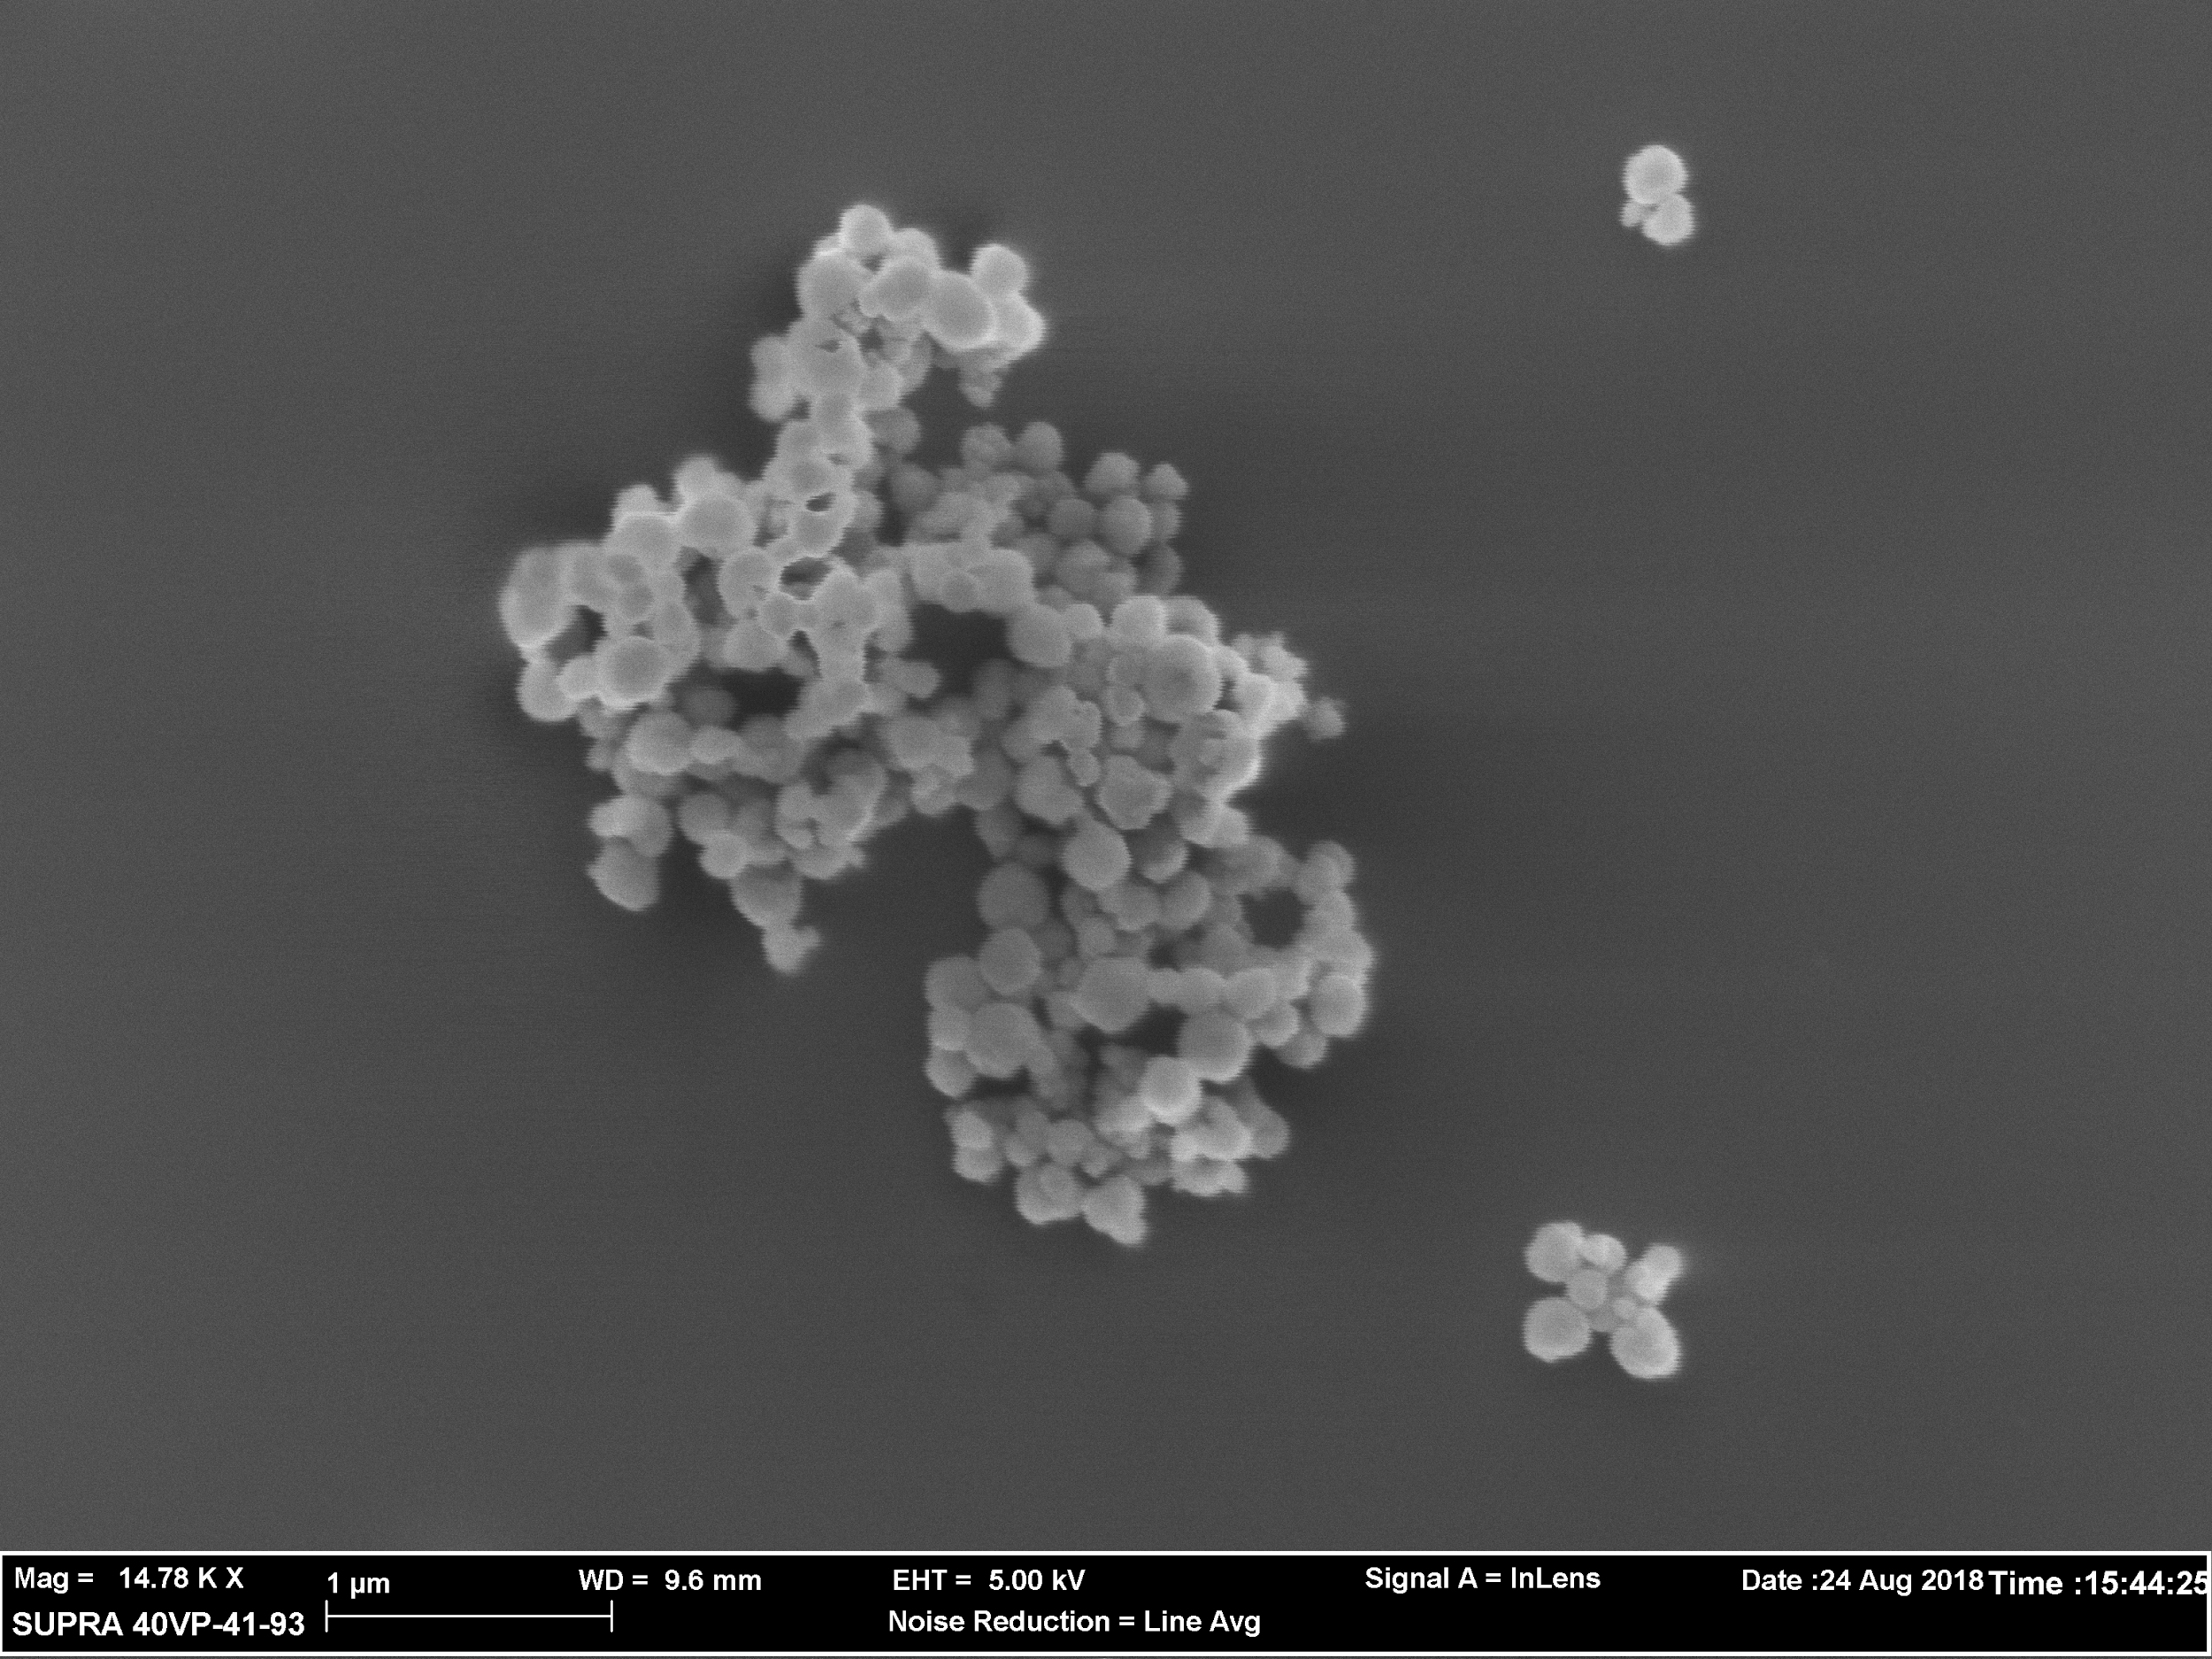
Sample 8
0.2 M NaOH was used, reaction ran for 30 minutes at 70° C then removed from heat and stirring.

Slide 8
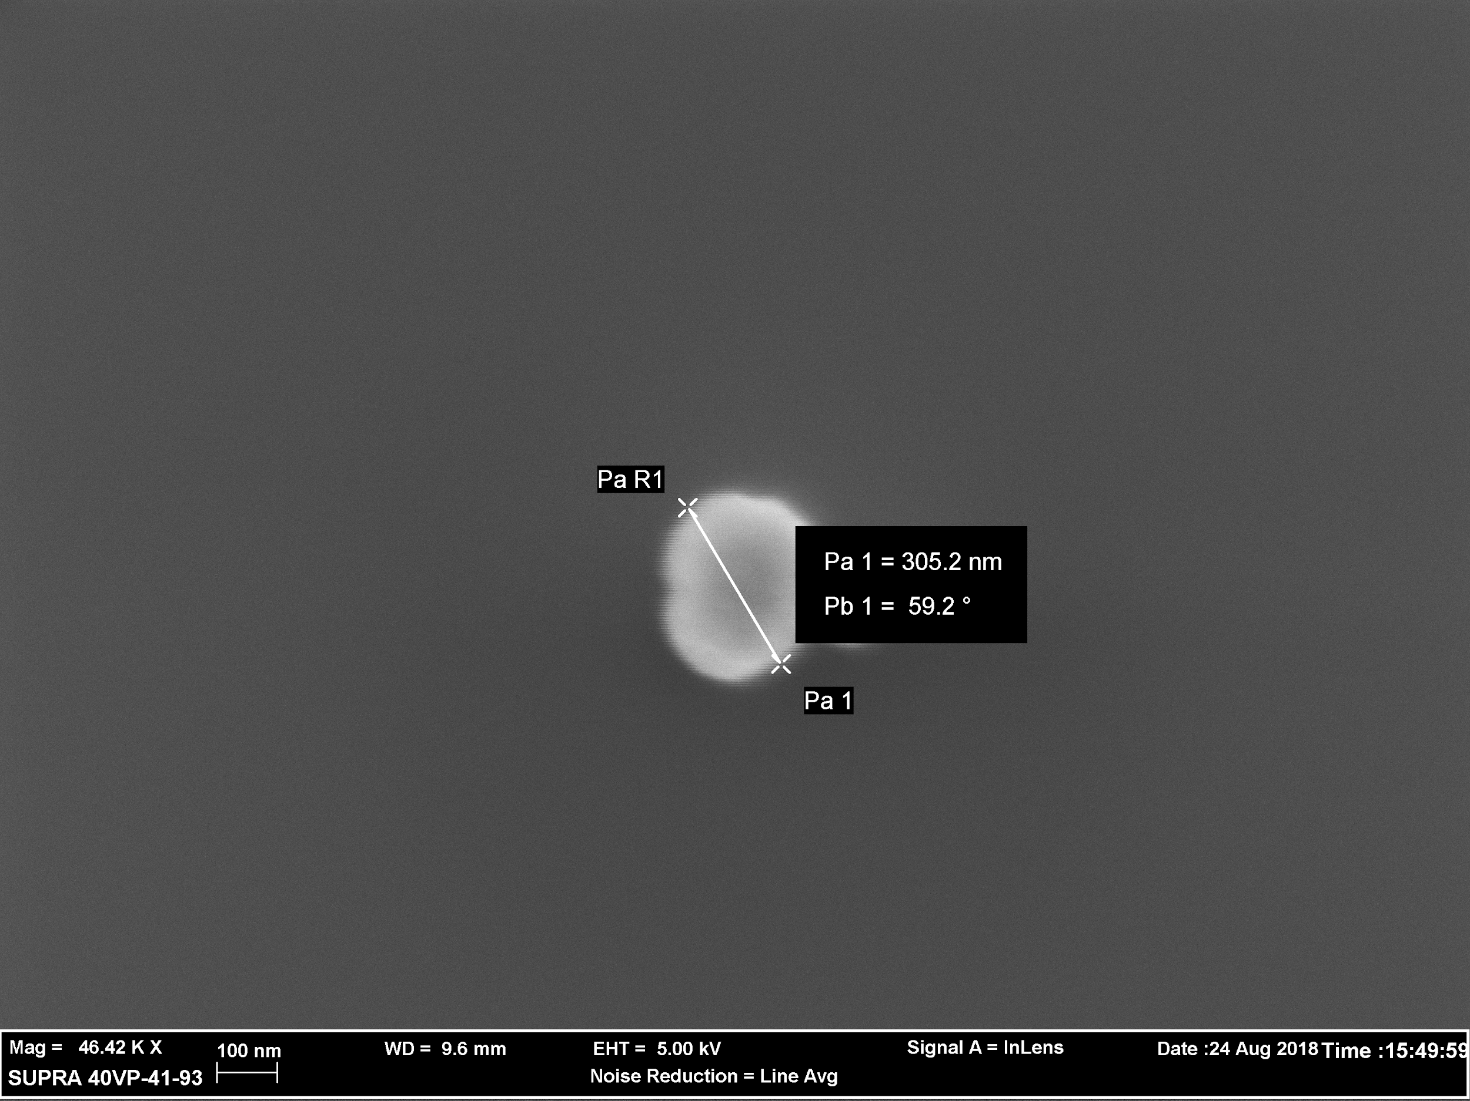

Slide 9
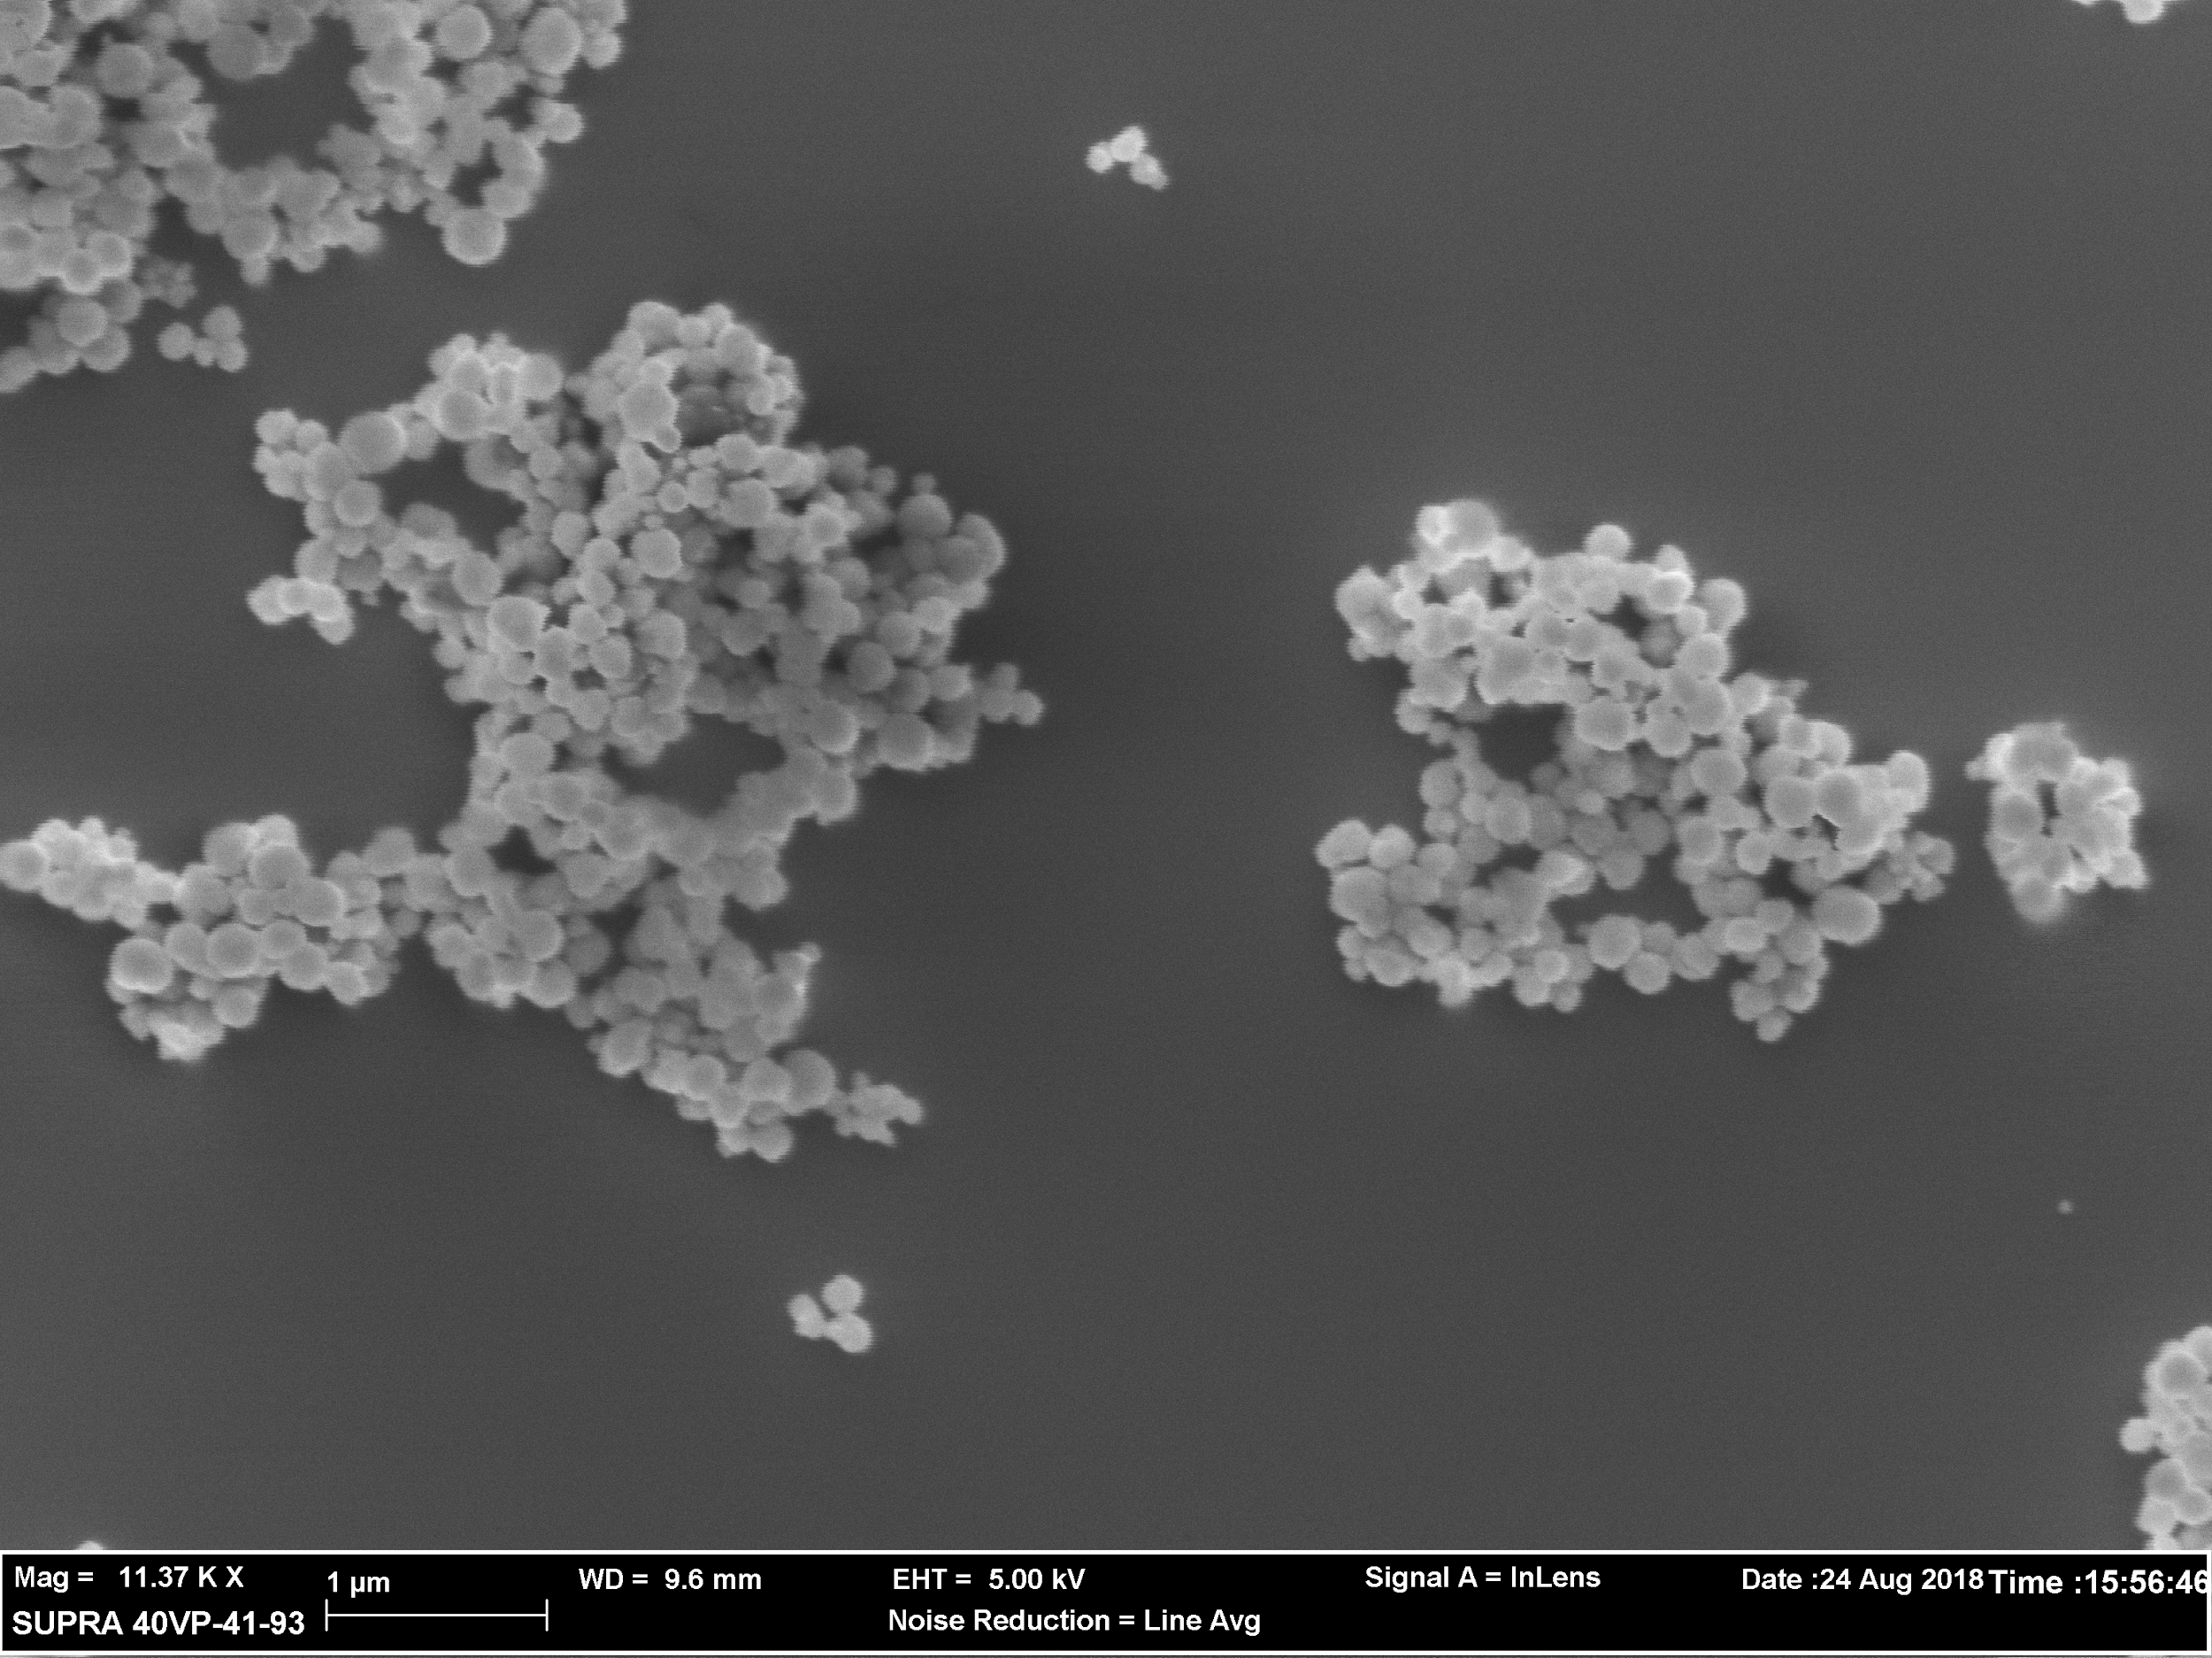

Slide 10
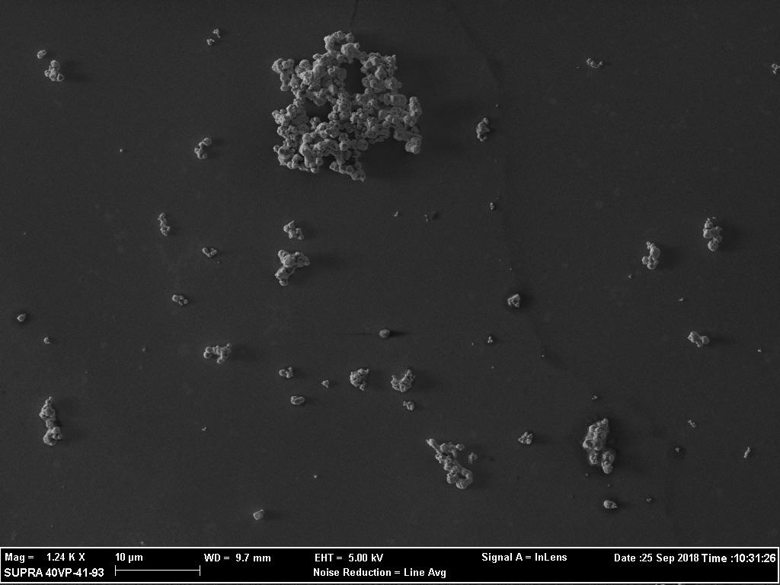
Sample 18
1 M NaOH was used, reaction was ran at 50° C for one hour then taken off heat and stirring.

Slide 11
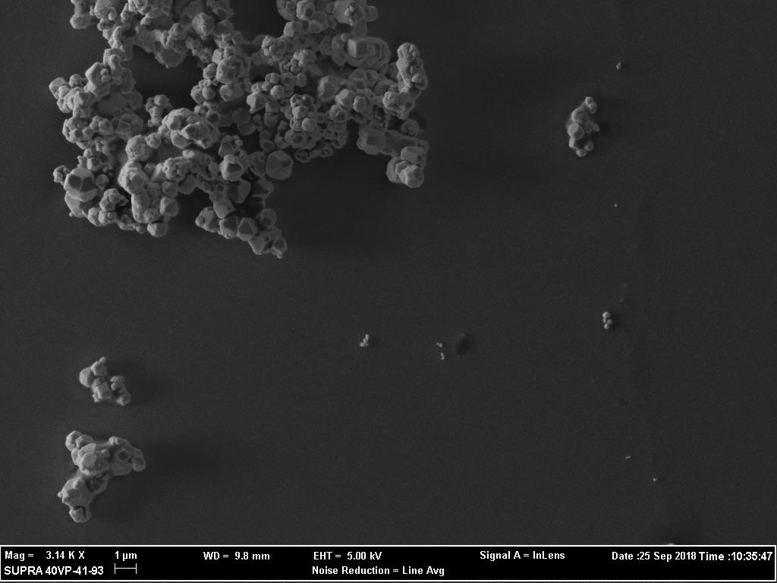

Dodecahedron

Slide 12
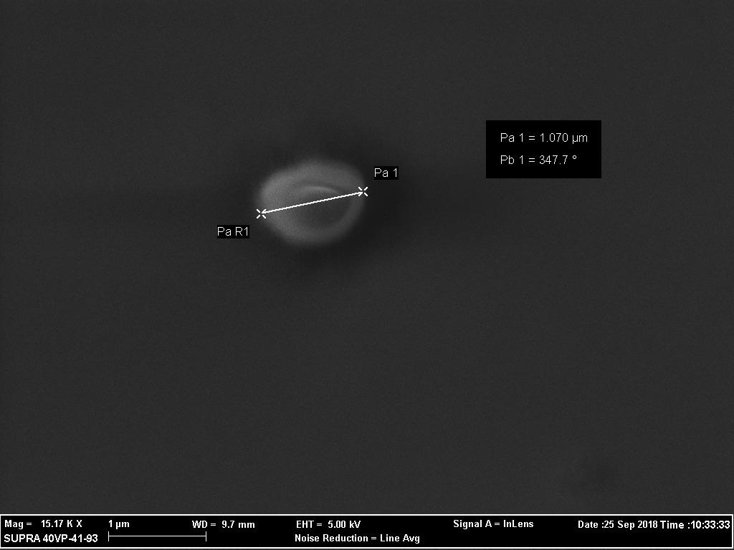

Slide 13
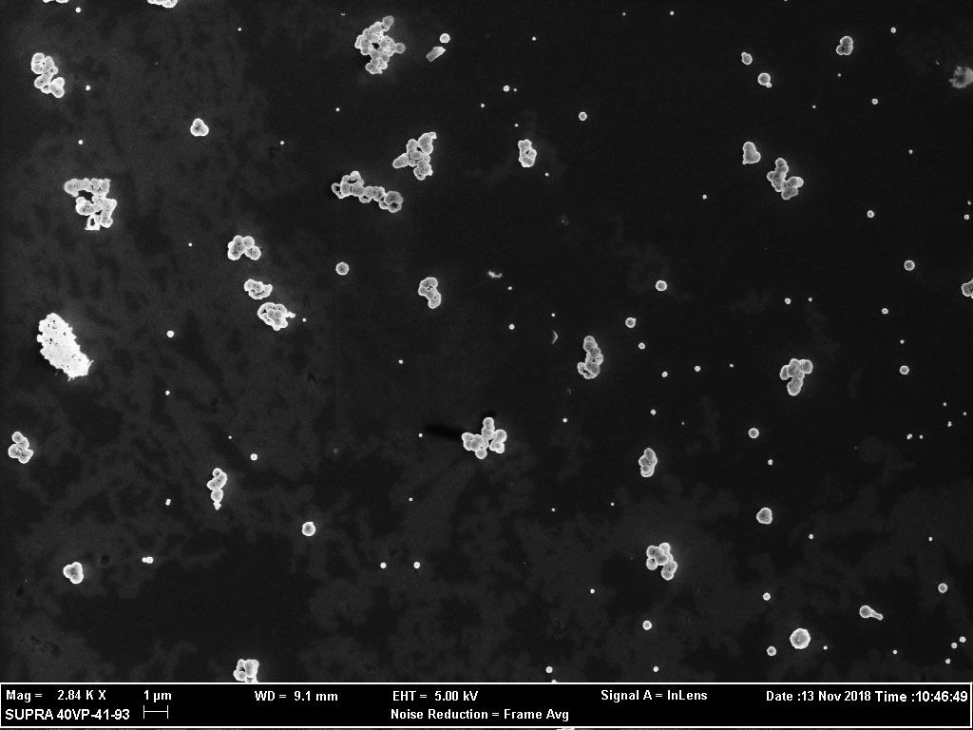
Sample 36-1
0.2 M NaOH was used, reaction ran for 2 hours at 50° C then removed from heat and stirred at room temperature for 24 hours.

Slide 14
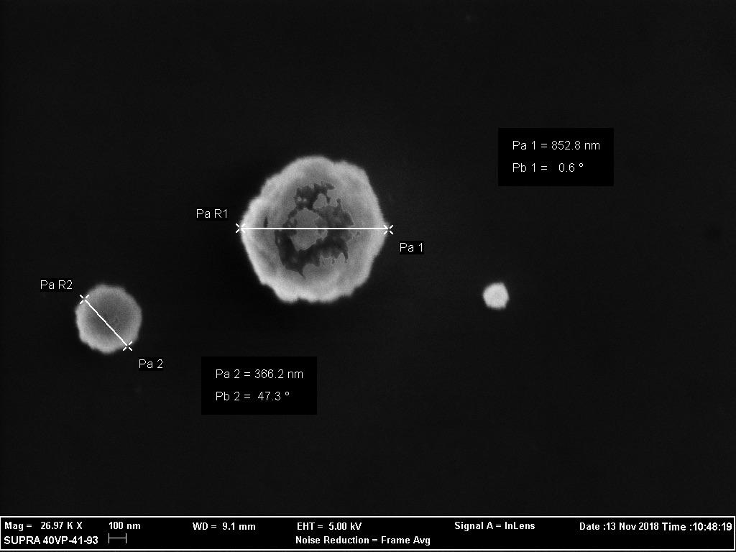

Slide 15
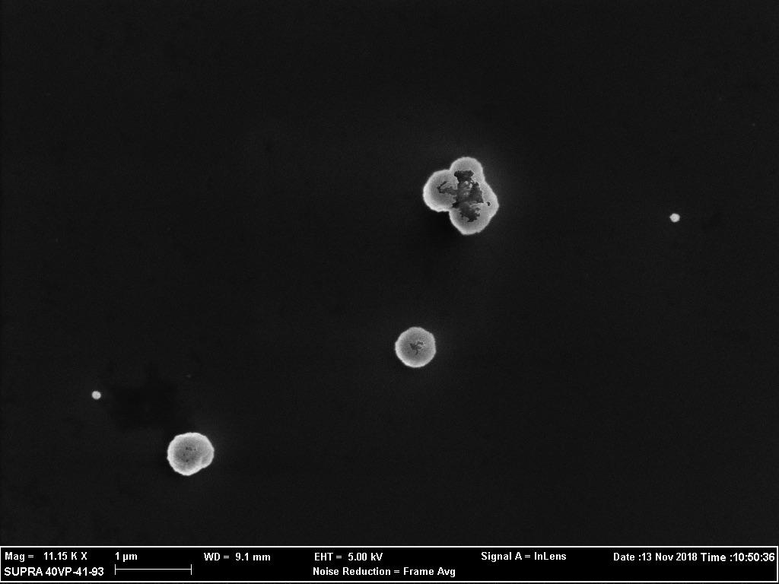

Slide 16
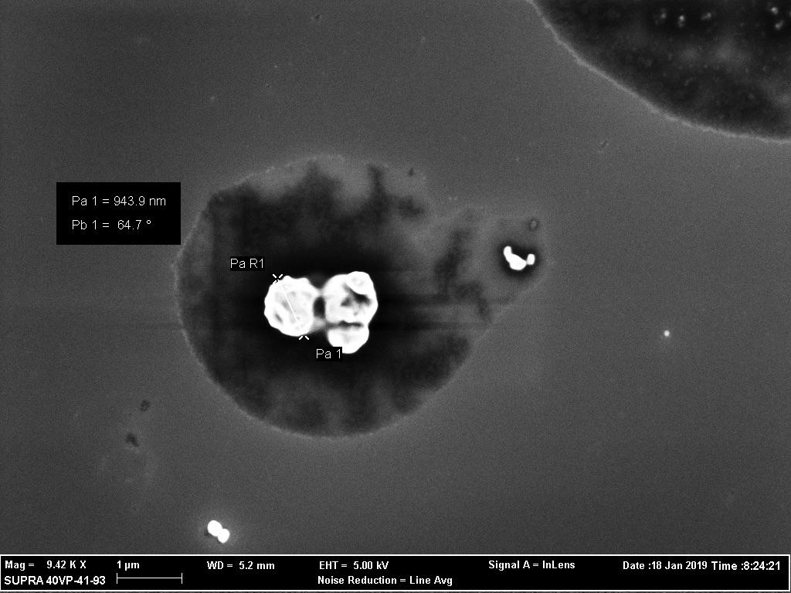
Sample 36-2
1 M NaOH was used, reaction ran for 2 hours at 50° C then removed from heat and stirred at room temperature for 24 hours.

Slide 17
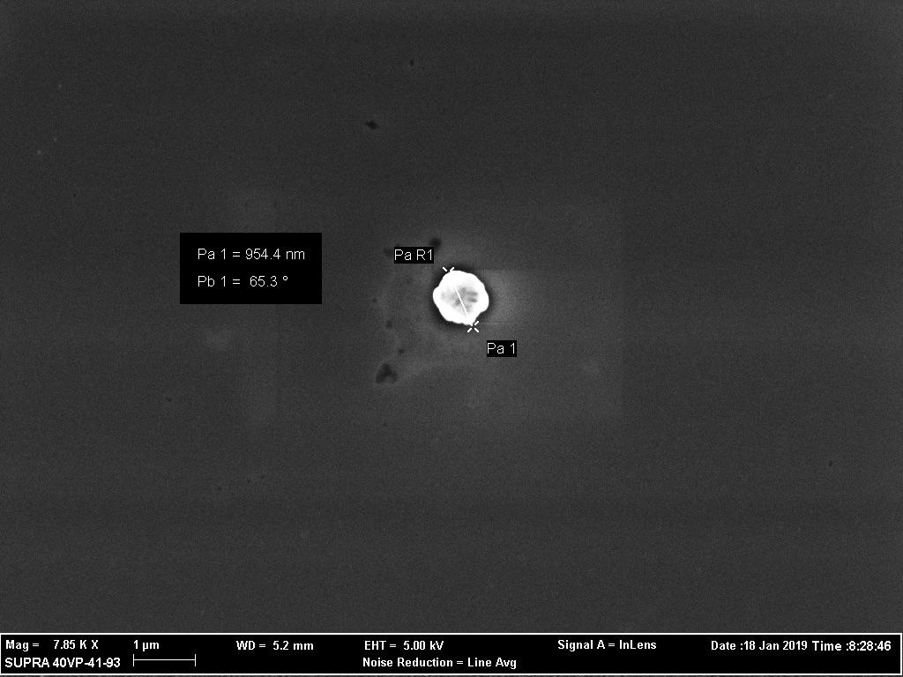

Slide 18
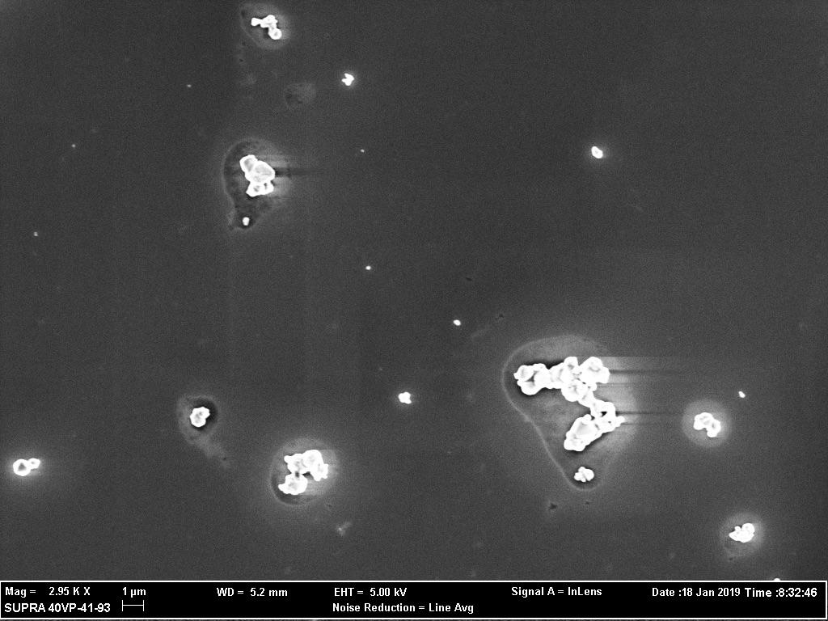

Slide 19
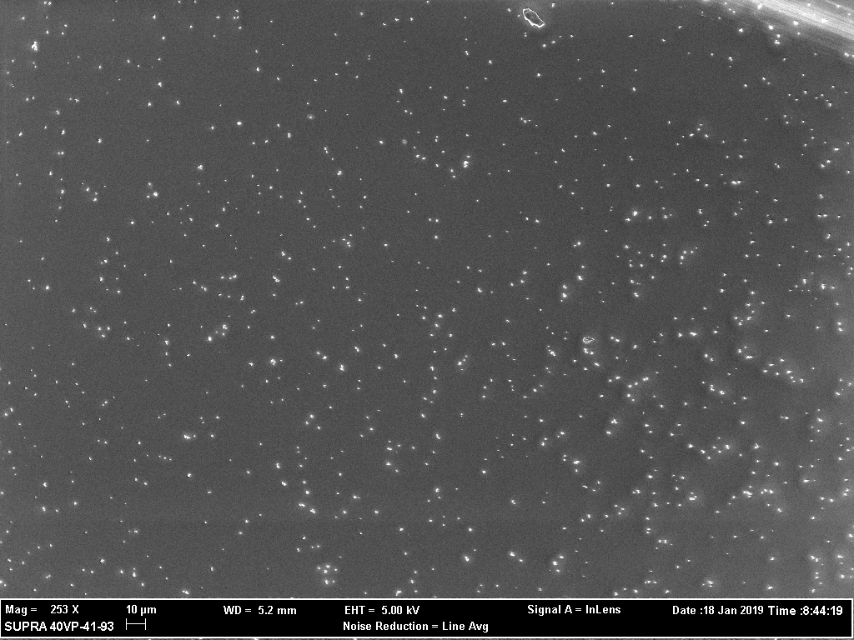
Sample 40
0.2 M NaOH was used, reaction ran for 30 minutes at 70° C then removed from heat and stirred at room temperature for 24 hours.

Slide 20
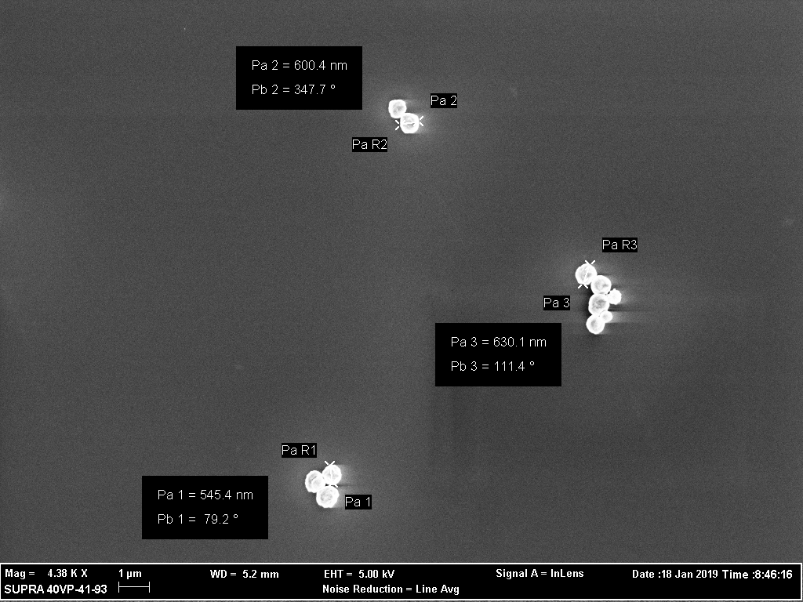

Slide 21
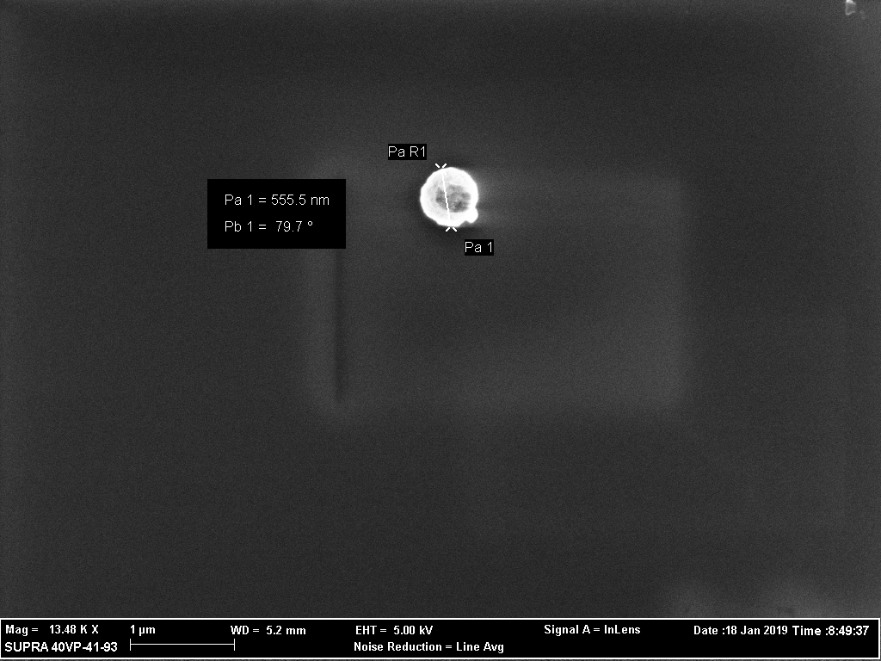

Slide 22
Conclusion
Sample | Temperature (°C) | Time of Reaction | Stirring Time (after addition of NaOH) | Molarity of NaOH (M)
8 | 70 | 30 min | 0 | 0.2
18 | 50 | 1 hour | 0 | 1
36-1 | 50 | 2 hour | 24 hour | 0.2
36-2 | 50 | 2 hour | 24 hour | 1
40 | 70 | 30 min | 24 hour | 0.2
Sample | Uniformity | Size | Dispersed
8 | yes | ≈300 nm | no
18 | no | ≈1 µm | no
36-1 | no | ≈300-600 nm | yes
36-2 | no | ≈900 nm | somewhat
40 | yes | ≈500-630 nm | yes

Slide 23

Acknowledgements
Special Thanks To
NAU NASA Space Grant
Clifford Coss, Edgar Civitello, and John Gibbs

